Slide 1

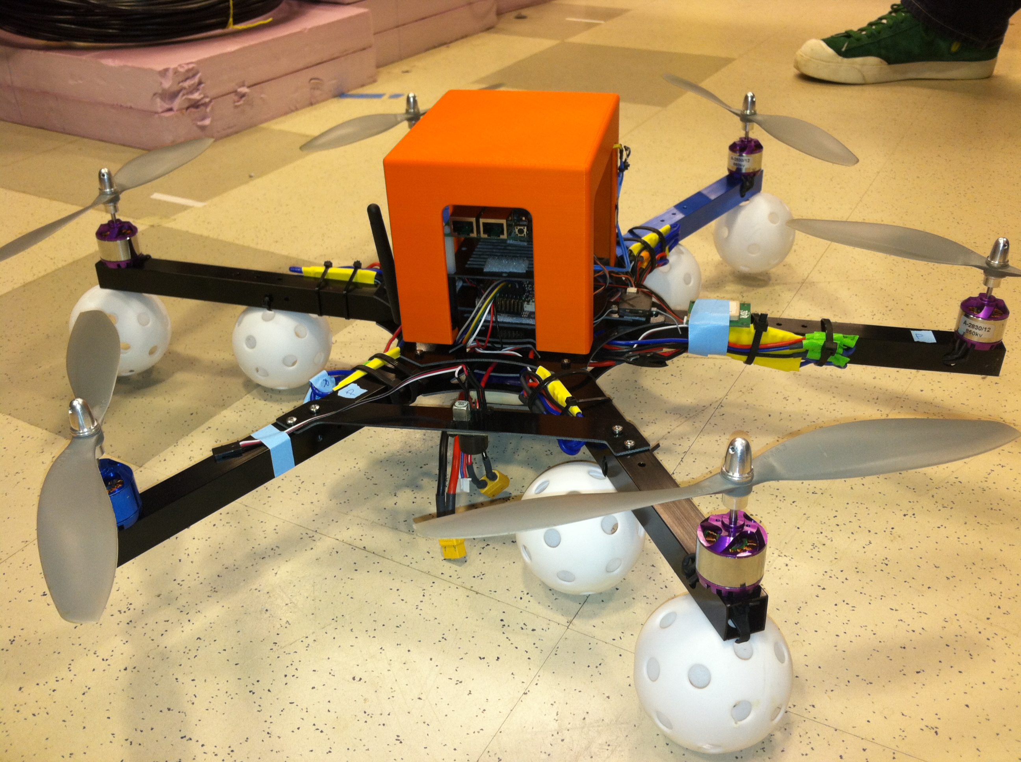
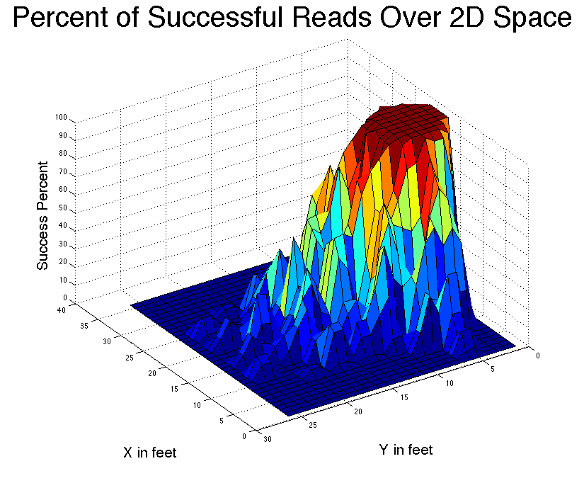
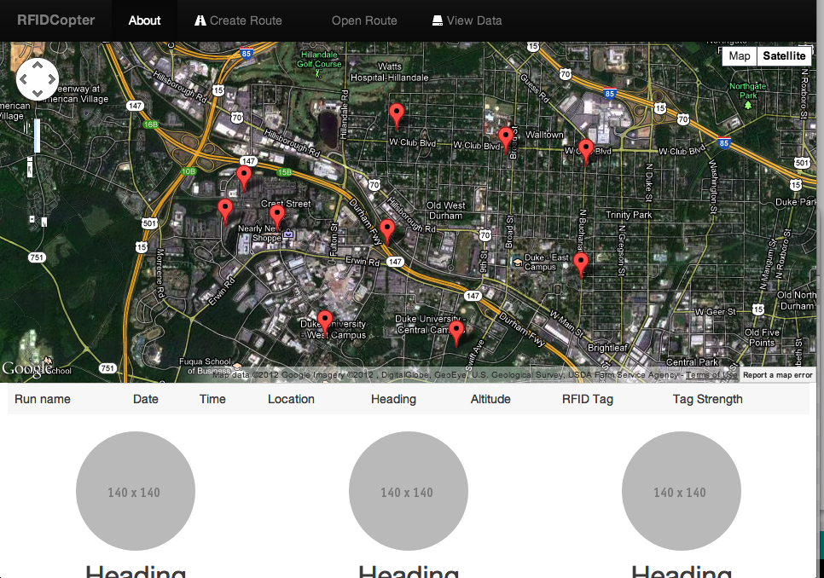
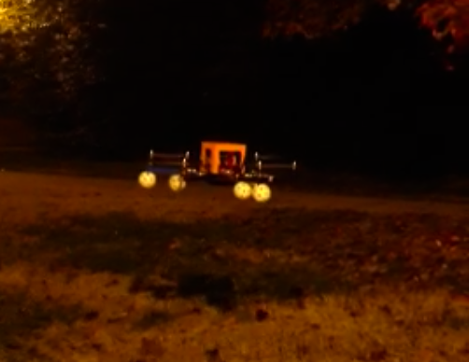
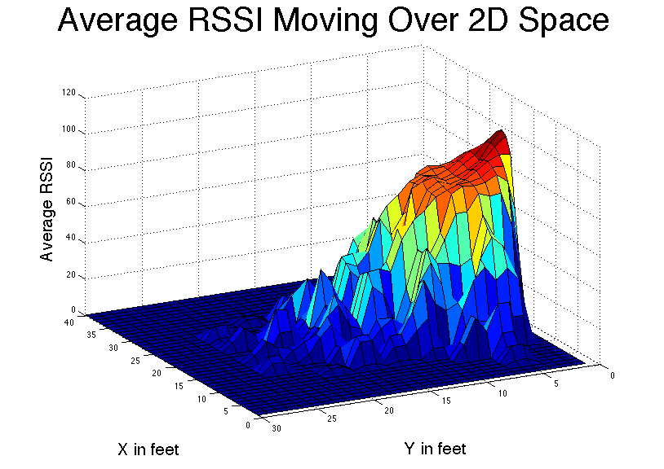
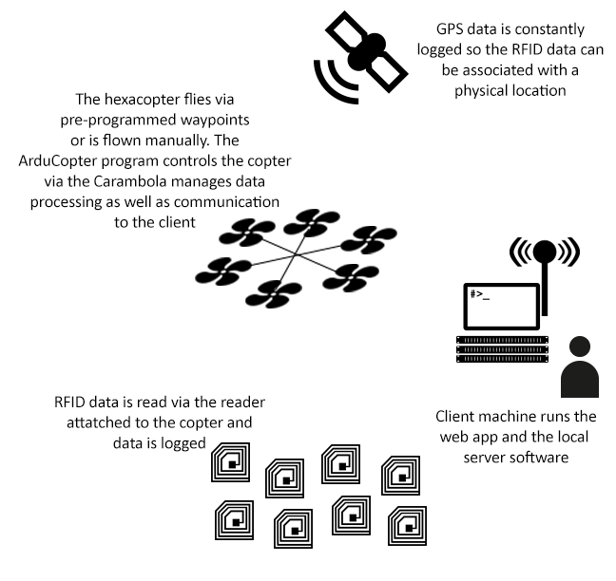
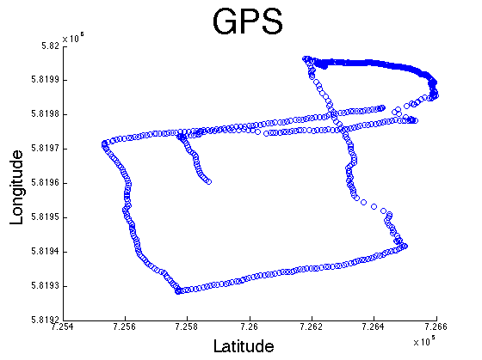
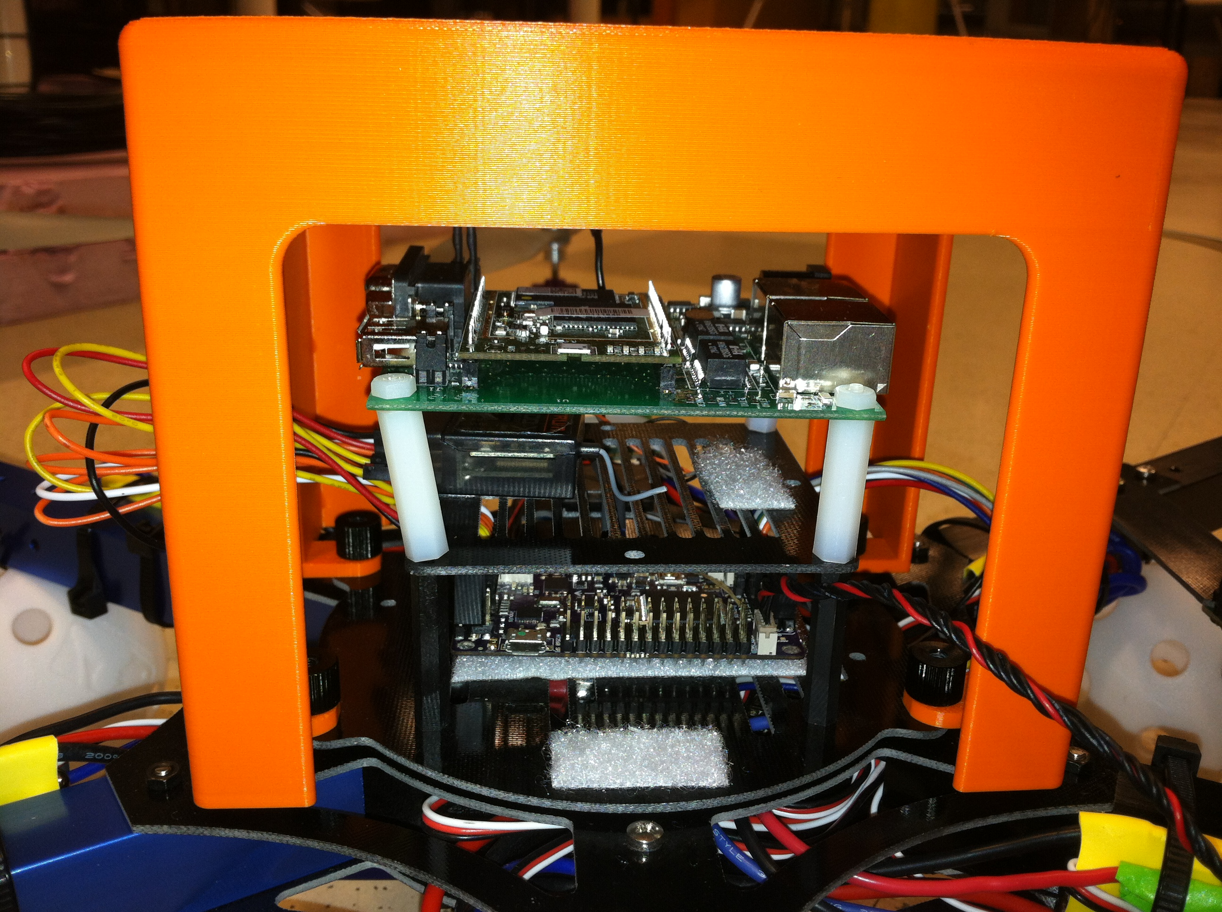
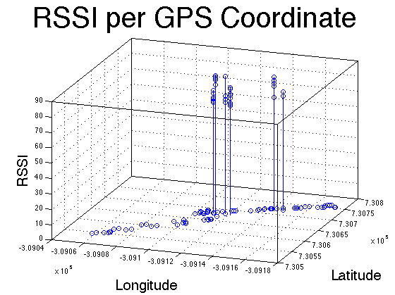
Long Distance RFID Reading Via Aerial Vehicles
Parker Kuivila. parker.kuivila@duke.edu
Senior, Electrical and Computer Engineering; Computer Science. with
Matt Reynolds, Travis Deyle, John O'Hollaren, Siddharth Kandan
Abstract
Hardware
Experimental Runs / Results
Web App Client
Radio-frequency identification currently has many applications dealing with wirelessly tracking items in shipping centers, stock warehouses, and inventory systems. Using passive tags allows for a scalable and relatively cheap solution to track large amounts of items with minimal hassle.
Using a combination of a the Carambola system on a chip, a GPS module, an RFID reader, and an ArduCopter hexacopter, a system has been developed to track and or read in data from RFID tags autonomously and conveniently. By utilizing an ArduCopter to serve as the vehicle of transportation for the system, we are able to read in data that may have previously been a hassle to access due to heights and other obstacles
The ArduCopter is able to take in a set of waypoints that a user predetermines. Given this set of waypoints, the copter will autonomously navigate itself from point to point. A web client was designed to make it easy for the user to graphically set where the ArduCopter should go.
Additionally, this web app will allow the user to load previous runs and view the location that the copter went as well as the RFID data that was read in at those corresponding points.
The program runs on Google App Engine and utilizes Python and Google’s Big Table data scheme to store the information.
System Overview
Further Work
Our current system was created to help users locate their cars in parking lots. By tagging each car with an RFID tag, our system can navigate the parking lot from above and record the various tags that are present. By recording the changing signal strength of each tag, in addition to the coordinates of the hexacopter at the time of the recording, we can determine where each tag is located.
By combining the hardware we have combined with a web application, we are able to show users where their cars are. Our system can also be expanded to read any RFID tag and associated information. Due to the nature of the hexacopter, this system can access RFID tags in places normally out of reach for humans such as trees, tall buildings, bridges, volcanoes, and any area with obstacles.
Currently there is a large movement in the RFID community to develop wirelessly powered tags. When the tags detect a radio signal from the RFID reader, they are powered and then can transmit relevant information to the reader. This differs from traditional RFID tags that only transmit their unique ID.
These tags are used in structural stress monitoring in bridges and other concrete structures. While the RFID technology makes it easier to read this data, it is still difficult to get in range in order to read the information. We believe that this project will make such monitoring a trivial matter, as the hexacopter is easily able to fly past structures, regardless of size, height, and obstacles. We would like to take this concept further and apply it to the issue of difficult to access RFID tags.
Our system resides on an hexacopter, which runs the ArduCopter software. The ArduCopter software is responsible for controlling the hexacopter and navigating it along its waypoints.
A Carambola resides on the hexacopter as well to handle the data input/output and management. The Carambola is connected to a GPS module, a WiFi chip, which allows for wireless communication to the client machine, an RFID reader, and a camera to take still images during the trips. The Carambola congregates the information and transmits it to the web application.
After taking in the GPS coordinates and the RFID signals, we convert the lat/long coordinates to Cartesian. Then we are able to plot the location of the ArduCopter and the strengths of the RFID tags at those points.

